Slide 1

MBA FMA: Financial Accounting and Reporting Process
Topic 2 — A comprehensive guide to the Financial Accounting and Reporting (FAR) process, covering the full accounting cycle from source documents through to financial statement preparation, double-entry principles, and the requirements for a sound reporting process.

Slide 2
What is the FAR Process?
As defined in Topic 1, Financial Accounting and Reporting (FAR) is the process of identifying, measuring, and reporting economic information to enable informed decision-making. The process, also referred to in some textbooks as the accounting and reporting cycle consists of five summary stages that transform raw transaction data into meaningful financial reports.
01
Collect Evidence
02
Books of Prime Entry
Ledger Entries
03
Collecting evidence of transactions using source documents.
Summarizing the information in source documents in books of prime entry.
Passing entries in the ledger using the concept of double entry (Debits and Credits).
04
Trial Balance
05
Financial Reports
Summarizing the balances in the ledger using the trial balance.
Preparing the financial reports for users and stakeholders.

Slide 3
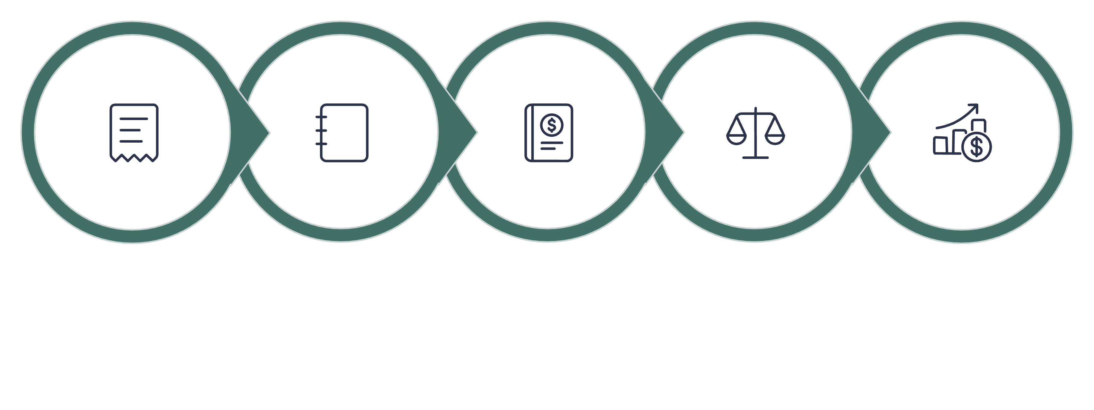
From Source Document to Financial Statement: The Full Cycle
Source Docs
Prime Entry
Ledger
Trial Balance
Financials
The FAR process is a continuous and interconnected cycle. Each stage depends on the accuracy and completeness of the previous one. Source documents provide the raw evidence; books of prime entry organize transactions by type; the ledger classifies and accumulates balances; the trial balance checks arithmetical accuracy; and the financial statements communicate the results to users. In a computerized system, many of these stages are automated, but the underlying principles remain the same.

Slide 4


Source Documents: Definition and Purpose
A source document is an original or supporting document that provides evidence of a financial transaction or event and serves as the basis for recording the transaction in an organization's accounting records. Source documents are critical for audit trails, authorization, accountability and verification because they provide documentary evidence supporting entries made in the accounting records.
Key point: Without reliable source documents, the integrity of the entire accounting and reporting cycle is compromised.

Slide 5
Source Documents: Invoices and Credit/Debit Notes
Sales Invoice
Purchases Invoice
Issued by a seller to a customer showing goods or services sold, quantities, prices, taxes and the total amount payable. Provides evidence of a credit sale and supports recognition of sales revenue and receivables.
Received from a supplier showing goods or services purchased, quantities, prices, taxes and the amount payable. Supports recording of purchases/expenses and payables.
Credit Note
Debit Note
Issued by a seller to reduce the amount previously invoiced to a customer, commonly due to goods returned, overcharging, discounts or other adjustments. Reduces the customer's amount payable and the seller's receivable/revenue.
Used to increase or adjust an amount previously invoiced, e.g. where the seller undercharged or additional charges arise. A buyer may also issue a debit note to notify a supplier of goods returned or an amount being claimed.

Slide 6
Source Documents: Cash, Vouchers, Bank Statements & Ownership
Cash Receipts
Cash Vouchers
Documents providing evidence that the organization has received cash or money, from customers, sale of assets or other income. They support recording of cash/bank receipts.
Documents prepared to provide evidence and authorization for cash payments or disbursements, such as payment for petty expenses, transport or supplies.
Bank Statements
Ownership Documents
Periodic statements issued by a bank showing deposits, withdrawals, transfers, bank charges, interest and the resulting bank balance. Used for recording and reconciling bank transactions.
Legal documents evidencing ownership or rights over assets e.g. vehicle logbooks, title deeds for land/buildings, and share certificates as evidence of ownership of shares in another company.

Slide 7
Books of Prime Entry: Overview
A Book of Prime Entry (also called a Book of Original Entry) is an accounting record in which financial transactions are first recorded from source documents before the relevant information is posted to the ledger accounts. These books help organize transactions by type and provide an important audit trail.
Journals
Cash Books
Registers
Record transactions according to their nature and type, particularly credit transactions and adjustments.
Record cash and bank receipts and payments.
Maintain detailed subsidiary records about assets, inventory, customers, suppliers and shareholders.

Slide 8
Journals: Sales, Purchases and Returns
Sales Journal
Purchases Journal
Records credit sales of goods or services made by the organization. Excludes cash sales. Example: credit sales to customers.
Records credit purchases of goods or services from suppliers. Example: credit purchases of inventory or other items bought on credit.
Returns Inwards Journal
Returns Outwards Journal
Also called the Sales Returns Journal. Records goods returned by customers to the organization e.g. defective, damaged or incorrectly supplied goods.
Also called the Purchases Returns Journal. Records goods returned by the organization to suppliers e.g. defective, damaged or incorrectly supplied goods.

Slide 9
Journals: General Journal and Payroll Journal
General Journal
Payroll Journal / Payroll Records
Records transactions that do not normally fit into the specialized journals, together with appropriate explanations and supporting references.
Examples: Opening entries, correction of errors, depreciation, bad debts, transfers, accruals and other adjustments.
Records employees' gross pay, deductions and net pay, providing the basis for recording payroll costs and amounts payable to employees and authorities.
Examples: Salaries, PAYE/tax deductions, pension contributions, insurance deductions and net salaries payable.

Slide 10

Cash Books
Petty Cash Book
Cash Book — Cash at Bank
Records small-value cash receipts and payments made from cash held on the organization's premises.
Examples: Stationery, postage, local transport, refreshments and minor office expenses.
Records cash transactions conducted through the organization's bank account, including receipts, payments and transfers. It can also serve as both a book of prime entry and part of the ledger.
Examples: Bank deposits, customer receipts, cheque/EFT payments, bank charges and transfers.

Slide 11
Registers
Non-Current Asset Register
Inventory Register
Credit Customers Register
A detailed record of the organization's non-current assets, including identification, cost, location, depreciation and disposal details. Examples: land, buildings, motor vehicles, machinery, furniture and computers.
Records details of inventory held, including quantities received, issued, balances and values. Examples: raw materials, finished goods, merchandise and consumable stores.
Contains information about customers who purchase on credit, including transactions and amounts outstanding. Examples: customer names, invoices, credit notes, payments and outstanding receivables.
Credit Suppliers Register
Shareholders Register
Contains information about suppliers from whom the organization purchases on credit, including amounts owed. Examples: supplier invoices, debit/credit notes, payments and outstanding payables.
A statutory record identifying the organization's shareholders and their shareholdings and relevant changes in ownership. Examples: shareholder names, number and class of shares held, transfers and changes in ownership.

Slide 12
The Ledger: Definition and Categories
A ledger is the main accounting record where transactions are classified and recorded under individual accounts. It is used to determine the balance of each account and provides the basis for preparing the trial balance and financial statements.
Sales Ledger
Purchases Ledger
General Ledger
Contains the accounts of credit customers who buy goods or services from the business on credit. Shows how much each customer owes the business.
Contains the accounts of credit suppliers from whom the business buys goods or services on credit. Shows how much the business owes each supplier.
Contains all other accounts not maintained in the sales or purchases ledgers. Records the business's assets, liabilities, capital, income and expenses.

Slide 13

Double-Entry Accounting: The Fundamental Principle
Double-entry accounting is the principle that every financial transaction affects at least two accounts, with an equal amount recorded as a debit (Dr) in one or more accounts and a credit (Cr) in another account or accounts.
The fundamental rule: Total Debits = Total Credits
This system is based on the accounting equation: Assets = Liabilities + Capital (Equity). Debit and credit do not simply mean increase and decrease their effect depends on the type of account being recorded.

Slide 14
Debit and Credit: Rules by Account Type
Account Type
Debit (Dr)
Credit (Cr)
Normal Balance
Assets
Increase
Decrease
Debit
Liabilities
Decrease
Increase
Credit
Capital/Equity
Decrease
Increase
Credit
Income/Revenue
Decrease
Increase
Credit
Expenses
Increase
Decrease
Debit
Contra-assets (e.g. accumulated depreciation, ECL allowance)
Decrease
Increase
Credit

Slide 15
General Approach to Recording Transactions
A useful approach when recording any transaction is to ask three questions:
1
Which accounts are affected?
2
What type of accounts are they?
3
Has each account increased or decreased?
Identify all accounts that are impacted by the transaction.
Classify each account as an asset, liability, capital/equity, income or expense.
Determine the direction of change, then apply the debit/credit rules accordingly.
Account
If it Increases
If it Decreases
Example
Asset
Debit
Credit
Cash received → Dr Cash
Liability
Credit
Debit
Loan received → Cr Loan
Capital/Equity
Credit
Debit
Owner introduces capital → Cr Capital
Income
Credit
Debit
Sales made → Cr Sales
Expense
Debit
Credit
Rent paid → Dr Rent

Slide 16
Double Entry Examples 1 & 2
Example 1: Owner Introduces Sh 100,000 Cash
Example 2: Business Purchases Equipment for Sh 50,000 Cash
Two accounts are affected: Cash (Asset) increases and Capital (Equity) increases.
Equipment (Asset) increases and Cash (Asset) decreases.
Account
Debit
Credit
Account
Debit
Credit
Cash
100,000
—
Equipment
50,000
—
Capital
—
100,000
Cash
—
50,000

Slide 17
Double Entry Examples 3 & 4
Example 3: Business Receives a Bank Loan of Sh 200,000
Example 4: Business Pays Salaries of Sh 30,000
Bank/Cash (Asset) increases and Loan payable (Liability) increases.
Salaries expense increases and Cash/Bank decreases.
Account
Debit
Credit
Account
Debit
Credit
Bank
200,000
—
Salaries expense
30,000
—
Loan payable
—
200,000
Bank/Cash
—
30,000

Slide 18
Income and Expenses: Why the Treatment Can Seem Counter-Intuitive
The treatment of income and expenses can initially appear counter-intuitive:
Income is Credited
Expenses are Debited
Income is credited because it increases equity. When a business earns revenue, the owners' interest in the business grows, which is reflected as a credit to income accounts.
Expenses are debited because they reduce equity. When a business incurs costs, the owners' interest is diminished, which is reflected as a debit to expense accounts.
For example, if a business makes a credit sale of Sh 80,000:
Dr Trade receivables Sh 80,000
Cr Sales revenue Sh 80,000
The receivable is an asset, while sales income increases equity through profit.

Slide 19
Contra-Asset Accounts
A contra-asset account is an account that is presented against an asset and normally has a credit balance, thereby reducing the carrying amount of the related asset. Two important examples are accumulated depreciation and the ECL allowance.
(a) Accumulated Depreciation
(b) Expected Credit Loss (ECL) Allowance
An entity recognizes a loss allowance for expected credit losses on relevant financial assets such as trade receivables and loans. If an ECL allowance of Sh 5,000 is recognised:
Records the total depreciation charged on a non-current asset since acquisition. When depreciation of Sh 10,000 is recognised:
Dr Depreciation Expense Sh 10,000
Cr Accumulated Depreciation Sh 10,000
Dr Impairment Loss/ECL Expense Sh 5,000
Cr Loss Allowance for ECL Sh 5,000
The credit balance in accumulated depreciation reduces the carrying amount:
Cost – Accumulated Depreciation = Carrying Amount
Thus: Gross receivable – ECL allowance = Net carrying amount

Slide 20

The DEAD CLIC Mnemonic
A useful mnemonic for remembering the normal balance of each account type is DEAD CLIC:
Debit Side
Credit Side
Drawings/Dividends
Expenses
Assets
Debit normal balance
Capital
Liabilities
Income
Credit normal balance
For contra-assets: although they relate to assets, they normally carry a credit balance because they reduce the related asset. This is an important exception to the simple asset rule.
Account Category
Increase
Decrease
Assets
Debit
Credit
Liabilities
Credit
Debit
Capital/Equity
Credit
Debit
Income
Credit
Debit
Expenses
Debit
Credit
Contra-assets
Credit
Debit

Slide 21
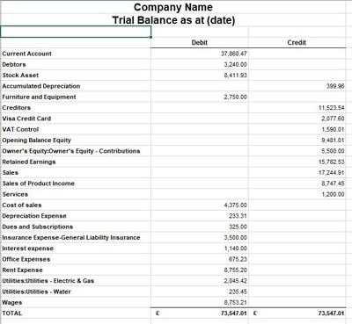
The Trial Balance: Definition and Purpose
A trial balance is a statement that lists the closing debit and credit balances of all ledger accounts at a particular date to check whether the total debits equal the total credits.
Check Arithmetical Accuracy
Confirms that total debit balances equal total credit balances, providing an initial check on the double-entry records.
Identify Errors
Helps detect certain accounting errors, such as one-sided entries, incorrect additions, or posting unequal amounts to the debit and credit sides.
Prepare Financial Statements
Provides the balances used to prepare the income statement/profit or loss statement and statement of financial position.
Summarize Ledger Balances
Brings together the balances from the various ledgers into one statement for easier review.

Slide 22

Trial Balance: Format and Limitations
Account
Debit (Dr)
Credit (Cr)
Assets
✓
Expenses
✓
Liabilities
✓
Capital
✓
Income
✓
Total
XXX
XXX
A trial balance that balances does not imply that all account balances are correct. Errors such as posting wrong debits or credits, posting wrong amounts, or omitting a transaction completely may not be highlighted in the trial balance.

Slide 23

FINANCIAL STATEMENTS
Overview of the Key Financial Statements
As highlighted in Topic 1, a complete set of financial statements provides users with a comprehensive picture of an entity's financial position, performance, cash flows and related disclosures. The following cards cover each of the six key financial statements in detail.
Statement of Profit or Loss
Statement of Financial Position
Cash Flow Statement
Notes to Financial Statements
Trial Balance
Each financial statement serves a distinct purpose and is presented in a specific format, together with explanatory notes that provide the context needed to understand the numbers.

Slide 24
Statement of Financial Position
What it Shows
Format / Presentation
The entity's financial position at a specific date, including assets, liabilities and equity. It shows what the entity owns, what it owes and the owners' residual interest.
Presented in a structured statement showing Assets = Equity + Liabilities. Assets are normally classified as current and non-current, while liabilities are classified as current and non-current.
Non-current assets: property, plant and equipment, intangibles, investments
Current assets: inventory, receivables, cash and equivalents
Equity: share capital, retained earnings, reserves
Non-current liabilities: long-term loans, deferred tax
Current liabilities: payables, short-term borrowings, accruals

Slide 25

Statement of Profit or Loss
What it Shows
Format / Presentation
The entity's financial performance over a period, including income, expenses and profit or loss.
Presented as a statement of income/revenue less expenses, resulting in profit or loss for the period. Expenses may be classified by nature (e.g. raw materials, staff costs, depreciation) or by function (e.g. cost of sales, distribution costs, administrative expenses).

Slide 26
Statement of Other Comprehensive Income (OCI)
What it Shows
Format / Presentation
Gains and losses recognised in equity through other comprehensive income rather than in profit or loss. Examples include:
May be presented in two ways:
Together with profit or loss in a single statement of profit or loss and other comprehensive income
As two consecutive statements: Statement of Profit or Loss followed by Statement of Other Comprehensive Income
Certain revaluation gains on property, plant and equipment
Foreign currency translation differences
Changes in the fair value of certain financial instruments

Slide 27
Statement of Cash Flows
What it Shows
Operating Activities
Cash inflows and outflows during the period and explains changes in cash and cash equivalents. Provides information about the entity's ability to generate and use cash.
Cash flows from the entity's principal revenue-generating activities. May be presented using the direct method (actual cash receipts/payments) or the indirect method (adjusting profit for non-cash items).
Investing Activities
Financing Activities
Cash flows from the acquisition and disposal of long-term assets and investments not included in cash equivalents.
Cash flows from activities that result in changes in the size and composition of the entity's equity and borrowings.

Slide 28
Statement of Changes in Equity & Notes to Financial Statements
Statement of Changes in Equity
Notes to the Financial Statements
Shows movements in the components of equity during the reporting period, including profit or loss, OCI, share capital, dividends, reserves and other changes in owners' equity.
Presented as a reconciliation of opening to closing equity balances, normally with separate columns for major equity components such as share capital and reserves.
Provide additional explanations, accounting policies, supporting details and disclosures necessary to understand the financial statements. They include:
Significant judgements and estimates
Commitments and contingencies
Risk disclosures
Detailed breakdowns of statement balances
Presented as numbered explanatory notes, normally arranged systematically and cross-referenced to the relevant financial statement line items.

Slide 29
MANUAL VS. COMPUTERIZED
Manual vs. Computerized FAR Process
A manual accounting process records, processes and summarizes financial transactions using paper-based or manually operated accounting records, such as invoices, journals, ledgers and physical trial balances. A computerized accounting process uses accounting software or an accounting information system (AIS) to capture, process, store and report financial transactions electronically. Many stages that are separate in a manual system are integrated and automated in a computerized system.
Manual Process
Computerized Process
Paper-based documents, manual journals, hand-posted ledgers, manually extracted trial balance, and manually prepared financial statements.
Electronic/scanned documents, automated posting to journals and ledgers, auto-generated trial balance, and financial statements generated directly from the accounting database.

Slide 30
Manual vs. Computerized: Stage-by-Stage Comparison
Stage
Manual Accounting Process
Computerized Accounting Process
1. Source Documents
Physical or manually prepared documents: invoices, receipts, payment vouchers, bank documents and credit notes.
Electronic or scanned documents: e-invoices, electronic receipts, digital payment records and uploaded documents.
2. Books of Prime Entry
Transactions are manually analysed and entered into journals and books of prime entry.
Transactions entered into electronic modules; system automatically posts to appropriate journals based on predefined rules.
3. Ledger
Entries manually posted to individual ledger accounts; balances calculated manually.
System automatically posts transactions to relevant ledger accounts and continuously updates balances.
4. Trial Balance
Ledger balances extracted and manually listed and totalled; errors may arise from incorrect extraction or posting.
System can automatically generate the trial balance; debits and credits auto-totalled, though not all errors are detected.
5. Financial Statements
Prepared manually from the trial balance, with adjustments for depreciation, accruals, provisions and inventory calculated manually.
Generated automatically from the accounting database once transactions and adjustments are correctly entered; reports updated whenever underlying data changes.

Slide 31

FAR REQUIREMENTS
Requirements for a Sound FAR Process
A sound Financial Accounting and Reporting (FAR) process should comply with legal requirements, professional accounting standards and recognised best practices. The objective is to ensure that financial information is accurate, complete, reliable, comparable, timely and useful for decision-making. The following cards detail the eleven key perspectives and requirements.

Slide 32
Legal/Regulatory and Accounting Standards Requirements
1. Legal / Regulatory
2. Accounting Standards
Requirement: Comply with applicable company, tax, employment, sector-specific and financial reporting laws and regulations.
Purpose: Ensures the entity meets its statutory obligations and avoids penalties or regulatory sanctions.
Requirement: Prepare financial statements in accordance with the applicable reporting framework, such as IFRS, IFRS for SMEs or relevant public-sector standards.
Purpose: Ensures consistency, comparability and appropriate recognition, measurement, presentation and disclosure.

Slide 33
Professional Requirements and Accounting Records
3. Professional Requirements
4. Accounting Records
Requirement: Apply relevant requirements of professional accountancy bodies and the IFAC ethical framework, including:
Requirement: Maintain complete, accurate and systematic accounting records, supported by appropriate source documents and an adequate audit trail.
Purpose: Provides reliable evidence for transactions and supports preparation and verification of financial statements.
Integrity and objectivity
Professional competence and due care
Confidentiality
Professional behaviour
Purpose: Promotes ethical and professionally competent financial reporting.

Slide 34
Double-Entry System and Financial Statements Requirements
5. Double-Entry System
6. Financial Statements
Requirement: Record transactions using the double-entry principle, ensuring that total debits equal total credits.
Purpose: Provides the basic mechanism for maintaining complete accounting records and detecting certain errors.
Requirement: Prepare a complete set of financial statements, including the statement of financial position, profit or loss and OCI, cash flows, changes in equity and notes, as applicable.
Purpose: Provides users with a comprehensive picture of financial position, performance, cash flows and related disclosures.

Slide 35
Disclosure and Timeliness Requirements
7. Disclosure
8. Timeliness
Requirement: Provide material accounting policies, judgements, estimates, commitments, risks and other required disclosures.
Purpose: Enables users to properly understand and interpret the financial statements.
Requirement: Close accounting periods and prepare reports within statutory, regulatory and management reporting deadlines.
Purpose: Ensures information is available when needed for decision-making and compliance.

Slide 36
Audit, Technology and Governance Requirements
9. Audit and Assurance
10. Technology and Data Management
11. Best Practice / Governance
Requirement: Maintain adequate documentation and records to facilitate internal audit, external audit, regulatory review and other assurance engagements.
Purpose: Provides evidence supporting the financial information and strengthens accountability.
Requirement: For computerized systems, implement appropriate access controls, backups, cybersecurity, data validation, change controls and system audit trails.
Purpose: Protects the integrity, confidentiality and availability of accounting information.
Requirement: Establish clear accounting policies, responsibilities, review procedures, reporting calendars and management oversight.
Purpose: Creates a disciplined and consistent financial reporting environment.

Slide 37
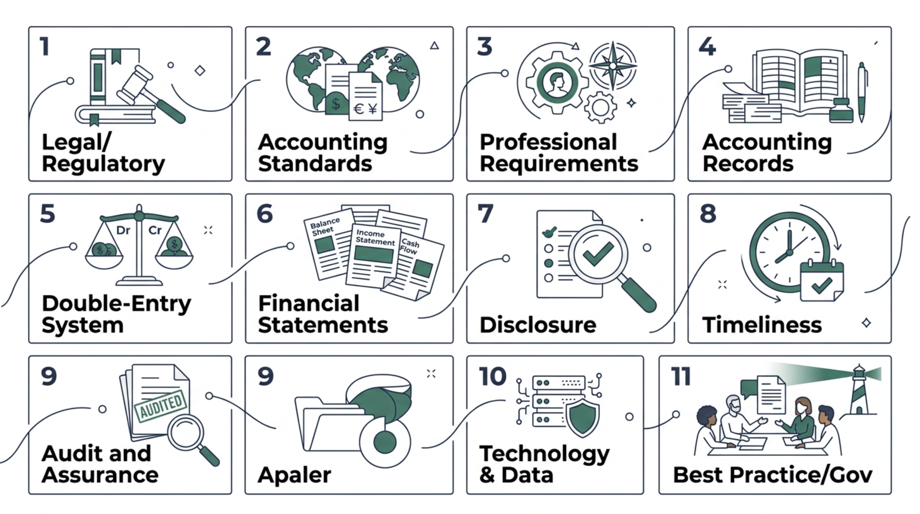
Summary: The 11 FAR Requirements at a Glance

Slide 38
Topic 2: Key Takeaways
The FAR Cycle Has Five Stages
Double Entry is the Core Mechanism
From collecting source documents through books of prime entry, ledger posting, trial balance and financial statements each stage builds on the last.
Every transaction affects at least two accounts. Total debits must always equal total credits. Use DEAD CLIC to remember normal balances. Contra-assets carry credit balances despite relating to assets.
Six Financial Statements Form a Complete Picture
Sound FAR Requires 11 Key Requirements
Legal compliance, accounting standards, professional ethics, complete records, double entry, full financial statements, disclosure, timeliness, audit readiness, technology controls and governance all underpin a reliable FAR process.
The statement of financial position, profit or loss, OCI, cash flows, changes in equity and notes together provide a comprehensive view of financial position, performance and cash flows.

